Slide 1
Nonce
Making Sense of Nonces

Slide 2
Blockchain
The blockchain serves as the public ledger.
Bitcoin blockchain ledger database size is 167.97 GB.
The blockchain database is managed autonomously through the use of a peer-to-peer network, along with a timestamp server.
Solves double spending issue.
See http://sebfor.com/how-bitcoin-mining-works/
Notes:
Briefly discuss here the history of blockchain.

Slide 3
Blockchain basics
The ledger is distributed across the network to others on the same network.
The ledger is also distributed to those who mine, called miners.
The goal of blockchain technology is to eliminate third parties and to provide an immutable ledger.
Notes:
Discuss what is blockchain.

Slide 4
Why an immutable ledger is ideal
Denotes something which can never be modified or changed.
Provides a global log of transactions, created by a consensus between the chain's participants.
Ensures that a blockchain transaction cannot be replaced or reversed because of cryptographic levels of validation.
https://www.coindesk.com/blockchain-immutability-myth/

Slide 5
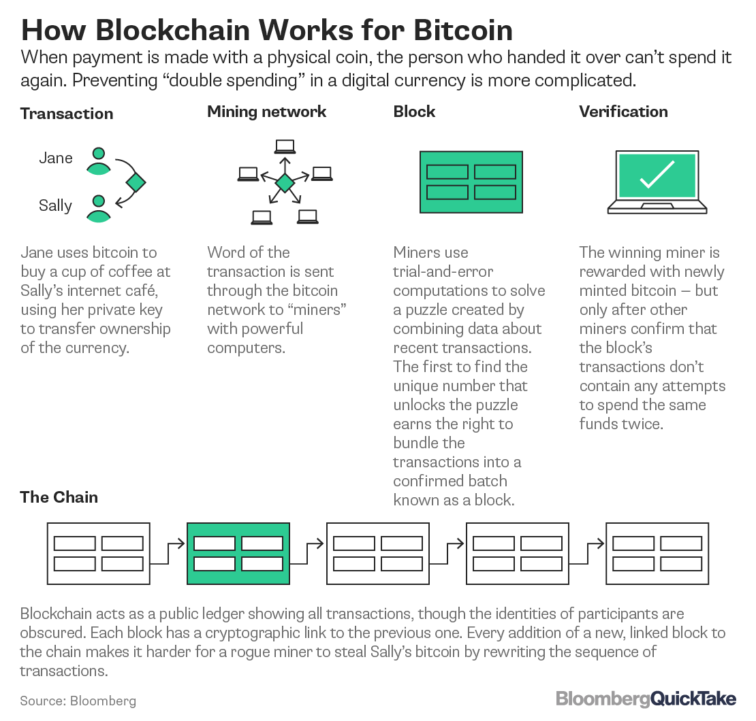

Slide 6
Nonce
Definition (American Heritage Dictionary): A word coined and used for a single or particular occasion.
I thought I invented a unique nonce to describe people full of beer.
“He was gambrious from drinking that stout ale.”
But gambrious is actually a word
Definition (cryptography): An arbitrary number used just once.

Slide 7
Blockchain Header
https://ethereum.stackexchange.com/questions/268/ethereum-block-architecture
Notes:
This is a overview of how the information within a block is compartmentalized and arranged.

Slide 8
Sally
Sally
Miner Bob
Miner Bob
Gets Bitcoin wallet from friend with 2 Bitcoins in wallet
Sends 1.5 Bitcoins to Bill with transaction fee of .05 Bitcoins
After verifying Sally’s Bitcoins, consolidates transactions into a block
Finds a SHA256 hash for entire block with 17 leading zeroes
Bill
Bill gets 1.5 Bitcoins and sees them in his wallet
Miner Bob
Miners
Bitcoin Software
Sally
Broadcasts to miners he found a SHA256 hash with 17 leading zeroes
Miners verify Bob’s claim that he has found SHA256 hash
Validated block is added to blockchain
Sally now has 1.55 fewer bitcoins in her wallet
Miner Bob
Gets 12.5 Bitcoins for mining block + transaction fees
Mining Process Simplified

Slide 9
2. Miner
Check to see if sender has Bitcoin
3. Miner
Assembles valid bitcoin transactions into block of 1 mb
4. Miner
Searches for a hash has the right number of leading zeros
5. Miner
broadcasts to other miners.
Transactions
Judy | 2 | Ralph
Hilary | 1.5 | Dan
Doug | .5 | Jill
Hank | 10 | Ralph
… | … | …
1. Transaction Pool
Judy sends Ralph 2 Bitcoins.
Hillary sends Dan 1.5 Bitcoins
Doug sends Jill .5 Bitcoins …
Block Chain Ledger
B1 | B2 | B3 | B4 | B5 | B6
B7 | B8 | B9 | B10 | B11 | B12
B13
6.Miners
Add validated transactions to block chain ledger

Slide 10
Nonce from a Crypto Perspective
“(Number ONCE) An arbitrary number that is generated to provide a unique identification or for security purposes such as when logging into a network (see initialization vector). The nonce is used only once and not repeated.
Although random and pseudo-random numbers theoretically produce unique numbers, there is the possibility that the same number can be generated more than once. However, if a very large, true random number is used, the chances are extremely small. A perfect nonce is the time of day; for example, 12.53 seconds past 5:13pm on 1/18/2012 because it can only occur once.”
Read more at http://www.yourdictionary.com/nonce#websters#Ubbks1qRqkVPVxlq.99

Slide 11
How the Nonce is Used in Mining
In the construction of a SHA 224,256, or 512 hash, this algorithm was developed by NSA.
A cryptographic hash is derived from a mathematical operation on text; it is used to make sure that the text has not been altered in any way.
In Bitcoin mining the SHA 224,256, or 512 hash, is generated by adding a nonce or unique value to the end of the text that is being hashed.
The goal is to generate a SHA256 hash that starts with zeros.
The nonce is the random number that is added to the end of the text being hashed until the desired number of leading zeros are generated.
This adding of a random number, or nonce, to generate a hash with leading zeros is what mining is all about.

Slide 12
Sally
Sally
Miner Bob
Miner Bob
Gets Bitcoin wallet from friend with 2 Bitcoins in wallet
Sends 1.5 Bitcoins to Bill with transaction fee of .05 Bitcoins
After verifying Sally’s Bitcoins, consolidates transactions into a block
Finds a SHA256 hash for entire block with 17 leading zeroes
Bill
Bill gets 1.5 Bitcoins and sees them in his wallet
Miner Bob
Miners
Bitcoin Software
Sally
Broadcasts to miners he found a SHA256 hash with 17 leading zeroes
Miners verify Bob’s claim that he has found SHA256 hash
Validated block is added to blockchain
Sally now has 1.55 fewer bitcoins in her wallet
Miner Bob
Gets 12.5 Bitcoins for mining block + transaction fees
Mining Process

Slide 13
Mining Complexity
It takes more time to generate a hash with 4 zeroes in front than 8 zeroes.
Hash with one zero requires about 16^¹ or 16 attempts.
Hash with two zeros requires about 16^² or 256 attempts.
Hash with three zeros requires about 16^³ or 4096 attempts.
Right now Bitcoin miners have to generate hashes with 17 leading zeros. This requires billions of calculations.
Watch these two videos for more information.
Solomon Lederer video
Gary Sims video.

Slide 14
Exercise 1
Go to: http://104.156.254.129/Exercise1.php
Enter in your name in the input box
Enter in a random integer value after your name and click submit.
If you see a SHA256 hash with a leading zero the exercise is completed. If not, repeat the above steps until you see a SHA 256 hash with a leading zero.

Slide 15
Exercise 2
Go to: http://104.156.254.129/Exercise2.html
Enter your name and the number of Bitcoins you want to give to a friend. (For example: Sean transfers 2 Bitcoins to Matt)
Enter 5 for the number of leading zeros to generate.
Enter SHA512 for the hashing algorithm.
What was total number of attempts?
What was the expected number of attempts?
How long did it take to find the nonce that generated the correct number of leading zeros?
What was the hash rate?

Slide 16
Exercise 3
Go to: http://104.156.254.129/Exercise3.html
Enter in your name and major
Check for 4 zeros
Select SHA256 for the hash
Let the simulation run for 10 iterations

